Slide 1
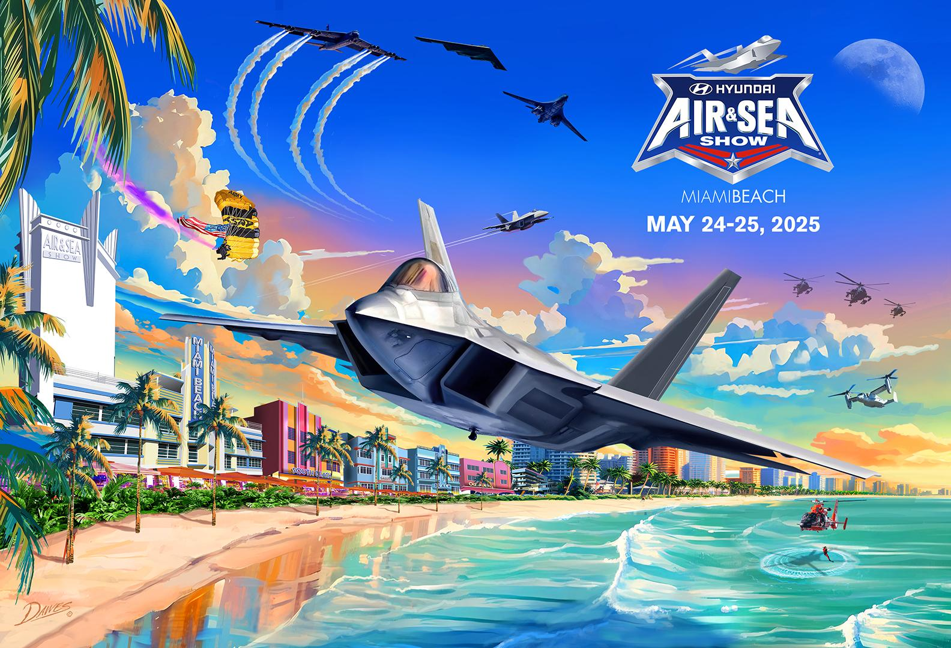

Slide 2
Dear Performer:
Welcome to the 2025 Hyundai Miami Beach Air & Sea Show, part of " The National Salute to America’s Heroes®”, on beautiful Miami Beach, Florida. The venue is proud of its association with you as a premier civilian or military / government agency participant.
The Air & Sea Show is designed to be a winner for everyone involved. For the military, it is an opportunity to showcase an impressive array of its personnel and equipment - encouraging patriotism and recruitment. This event also allows the American public to thank the military for their service in protecting our freedoms.
The people of South Florida also benefit with a signature event for the tri-county area. The show helps generate revenue for local businesses and charitable organizations, promotes community spirit, and provides a wholesome family and exciting event that is free to the public.
We hope that you and your crew have a great time here in South Florida and we will make every effort to make your stay enjoyable. Once again, thank you for your participation and support.
TO VIEW CLIPS OF PREVIOUS YEARS TV SHOWS AND ADDITIONAL EVENT INFORMATION:
www.usasalute.com

Slide 3
CONTACT LIST
Show Web Site: www.usasalute.com
Mickey Markoff - Executive Producer: mickey@mdmgroup.com o 954-649-4707
Ted Plana - Air Operations Director: burritoted@aol.com o 773-252-1644 c 954-649-4703
Jim Tucciarone - Air Show Director and Air Boss: jimtucc@aol.com c 216-390-8410
Glen “Lunar” Lawson – Safety Officer / Assistant Air Boss: lunarf16@aol.com c 757-927-4876
Lyle Holbrook – Assistant Air Boss: lyleholbrook@gmail.com c 416-659-0431
John “Rosie” Greer – Airport / MX Director: airshowgrunt@gmail.com c 615-692-9423
Nicole Lewis – Media Director: nicole@zuckerlewis.com 305-803-9177
Jennifer Kaminski – Social Media Director : jennifer @socialthinkking.com 305-978-5787
Please Send All Correspondence and Questions: burritoted@aol.com

Slide 4
ATTENDING SENIOR MILITARY
USAF Gen. Thomas Bussiere, Commander Global Strike Command
TBD
EQUIPMENT / PERFORMERS as of 30JAN25
US Army Golden Knights Parachute Team
British Red Devils Parachute Team
USAFR 920th Combat Search and Rescue Demo
USAF F-22 Demo Team
USAF Heritage Flight
USN F-18 Rhino Demo
USN Legacy Flight
USMC V-22 Demo
USAFR B-1
USAF B-2
USAF A-10’s
USAF KC-135
USAF C-17
USAF F-16’s
USAFR HC-130J
US Army Reserve MH-60’s
US Army AH-64 Apaches
USAFANG F-15’s
USAFR B-52
USCG Air Sea Rescue Demo
US Customs Border Protections Drug Interdiction Exercise
All Aircraft Are Subject To Operational Availability

Slide 5
Schedule of Events: Performers
Date and Time: | Subject: | Location:
Tues, 5/20/2025 1000hr | Safety/Emergency Meeting | Miami Beach Police Dept 1100 Washington Ave Miami Beach, FL 33139
Thurs, 05/22/2025 0900 - 1830 – 2100hr | Aircraft Arrivals Performer’s Party / Take-off Party | TBD
Fri, 05/23/2025 0700hr | Performer/Safety Brief | Miami Marriott Biscayne Bay 1633 N Bayshore Dr Miami, FL 33132
1000hr – NLT 1600hr | Practice Show | Show Center
1000hr – 1400hr | Media Day | US Coast Guard Air Station Miami 14750 NW 44th Court Opa-locka FL 33054
1830hr – 2100hr | Performer’s Party Espanola Way | 409 Espanola Way Miami Beach, FL 33139
Sat, 05/24/2025 0730hr | Performer / Safety Brief | Miami Marriott Biscayne Bay 1633 N Bayshore Drive Miami, FL 33132
Sun, 05/25/2025 0730hr | Performer / Safety Brief | Miami Marriott Biscayne Bay 1633 N Bayshore Drive Miami, FL 33132
Mon & Tues, 05/26 & 27/2025 | Aircraft Departures

Slide 6
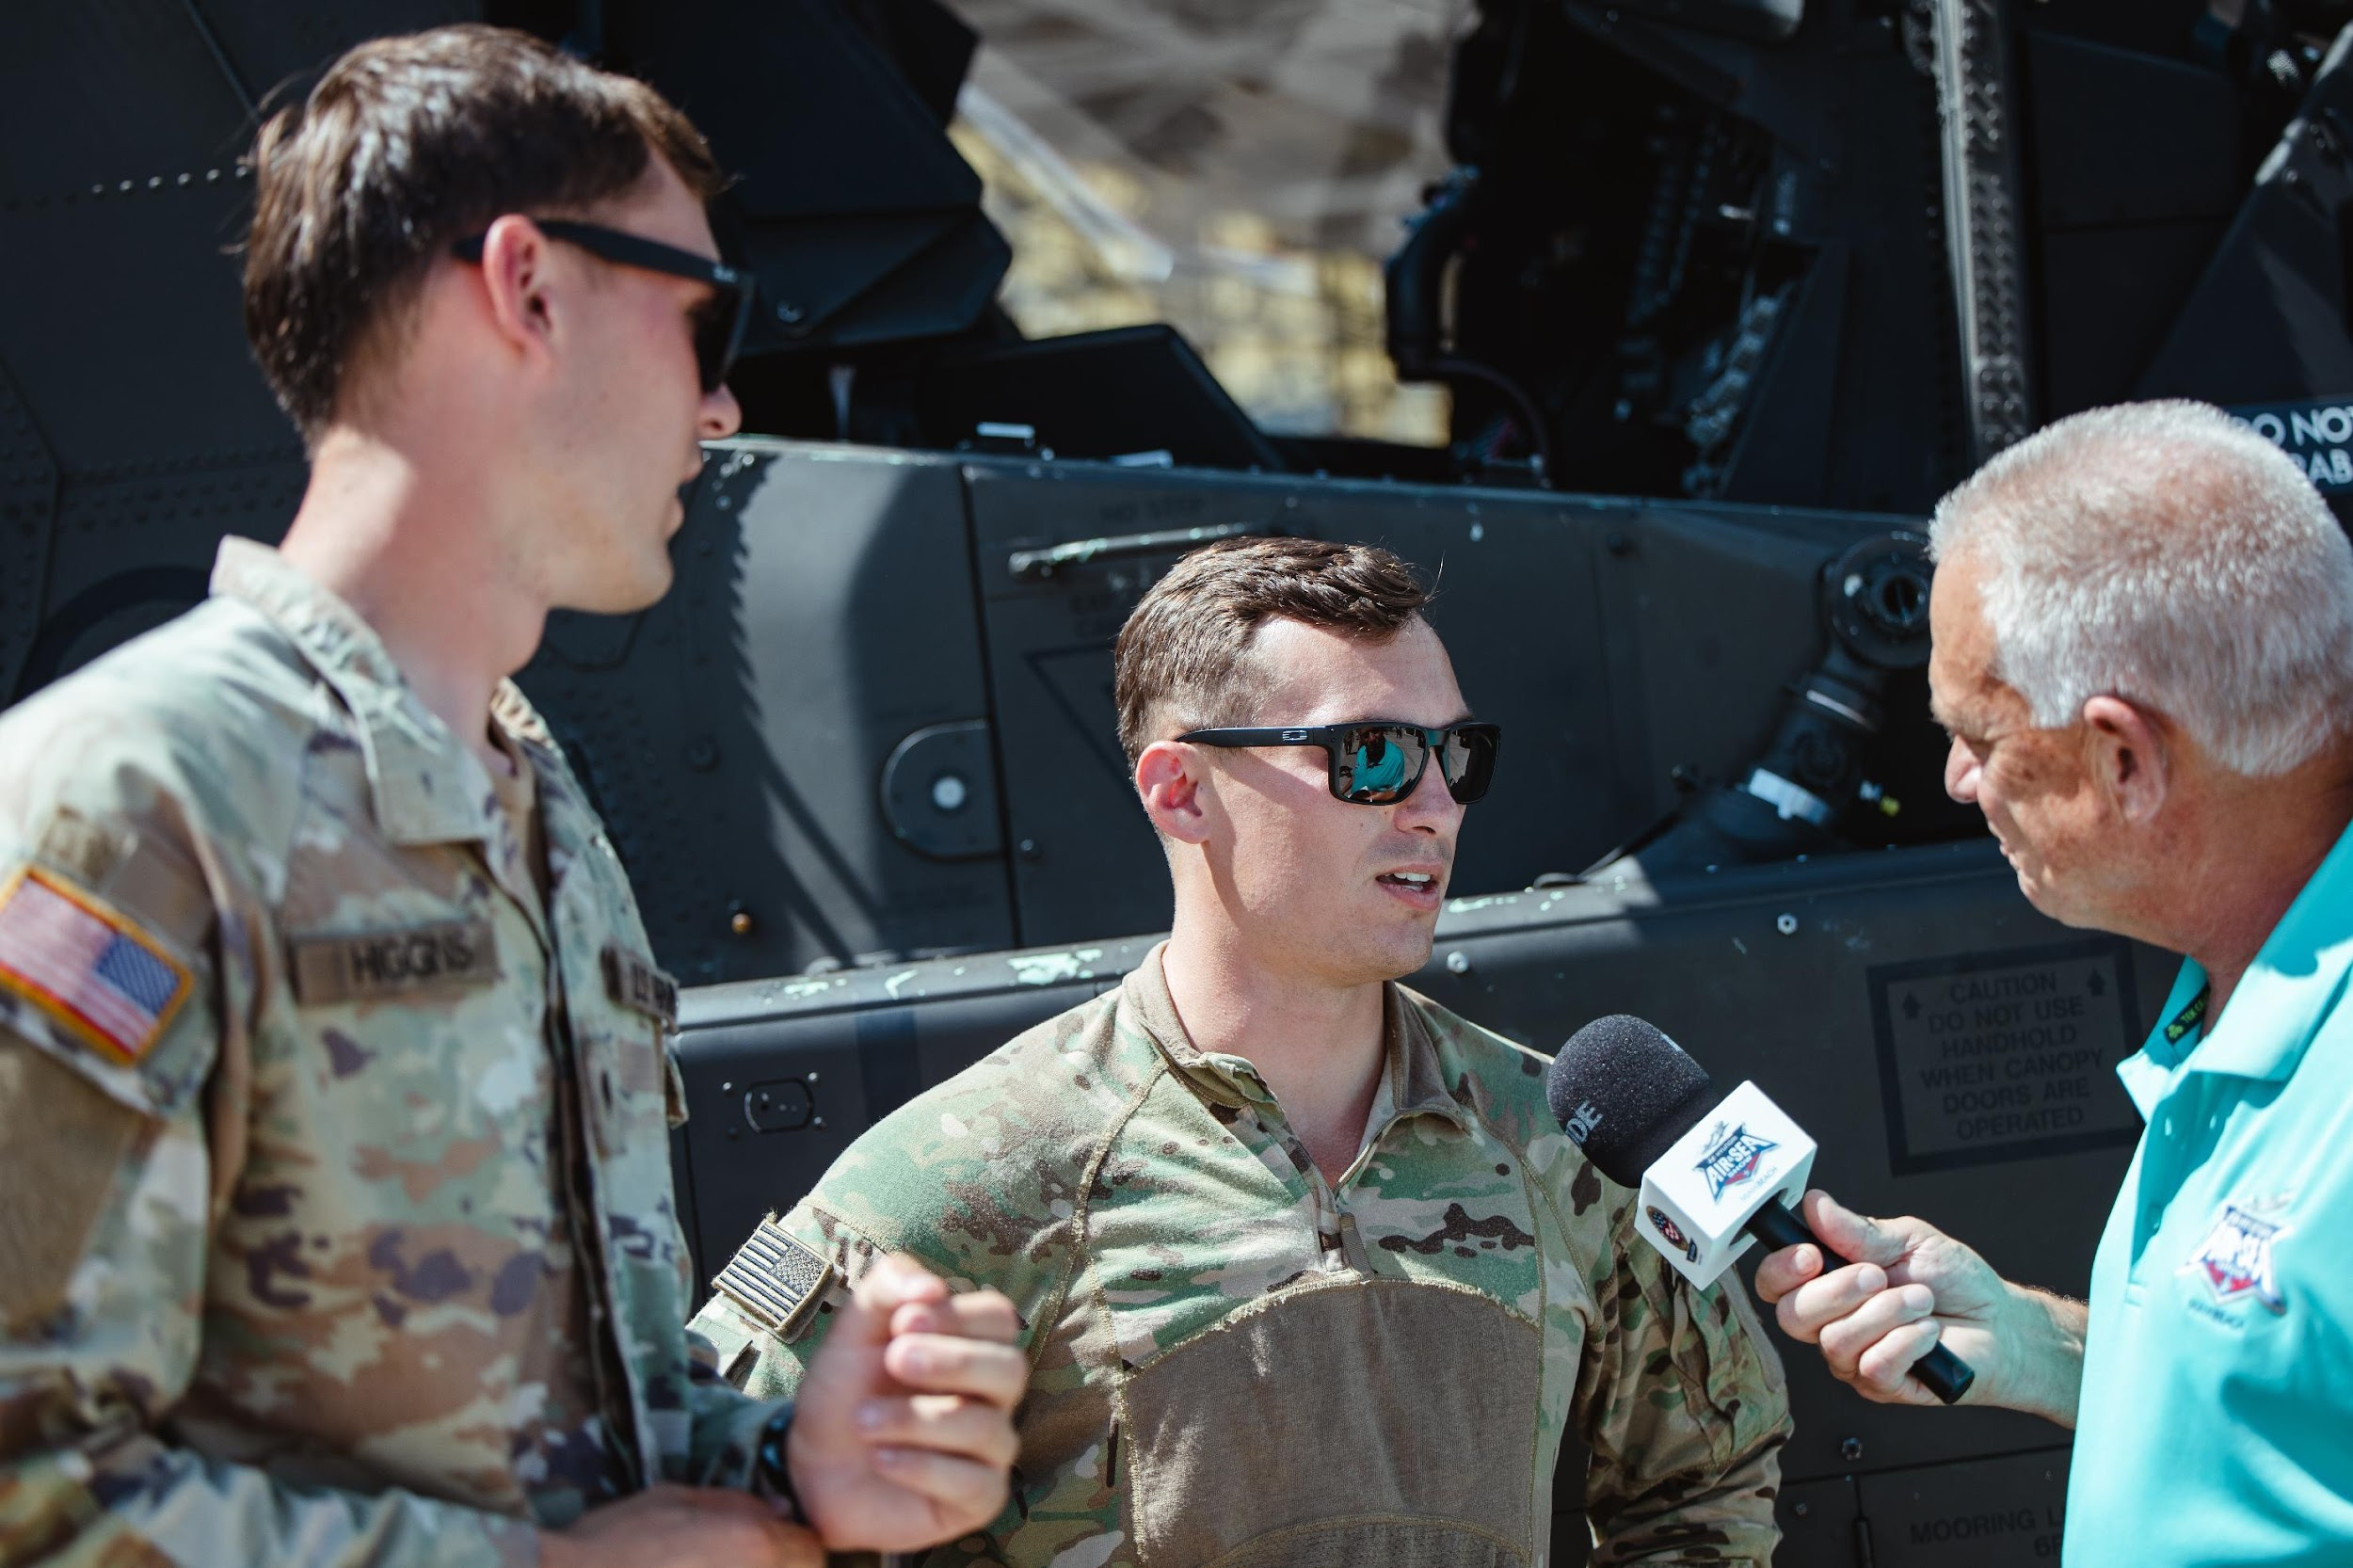
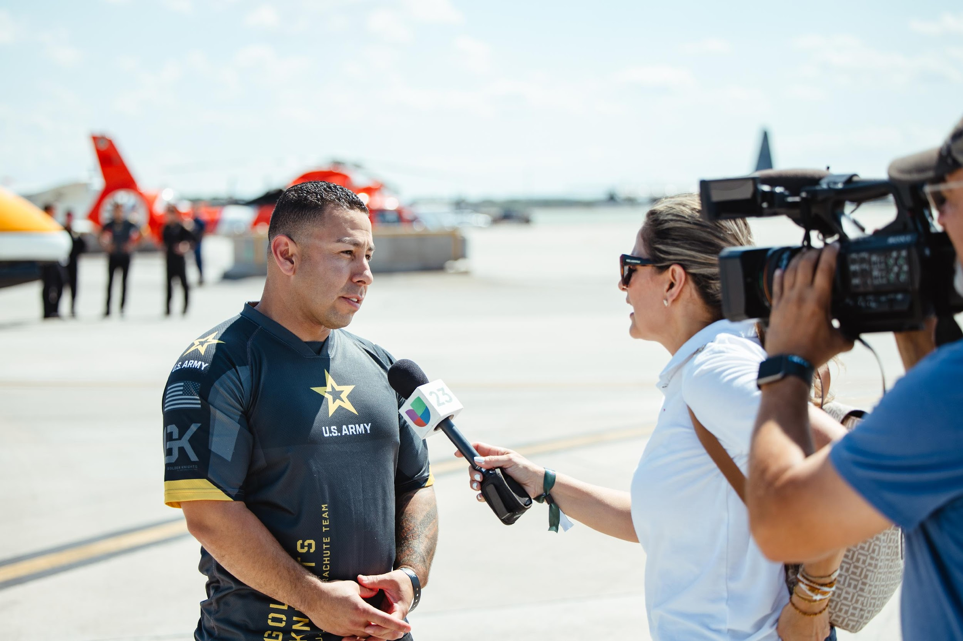
Media Days
Who: Media​
​
What: Media Interviews​
​
When: Thursday, May 22​
Friday, May 23 ​
10:00am – 2:00pm​
​
Where: US Coast Guard
Air Station Miami​
14750 NW 44th Court​
Opa-locka, FL 33054​
​
Why: Crew, Pilots and Planes​
​
POC: Nicole Lewis 305.803.9177​
Nicole@NLPR.Miami

Slide 7
LODGING & VEHICLES
HOTELS
Miami Marriott Biscayne Bay
1633 N. Bayshore Dr.
Miami, FL 33132
305-374-3900
Please Do Not Contact Hotel with Rooming List. Show Maintains and Submits.
Send Rooming List with Names and Arrive / Depart Dates to: burritoted@aol.com
VEHICLES (Rentals)
Please submit requested number of vehicles, Check In/Out Dates, Location (OPF / MIA / FLL), and Drivers Name.
Submit to: burritoted@aol.com

Slide 8
ITEMS NEEDED & NOTES
POC’s
Arrival and Departure Dates (include Aircraft Arrv)
Rooming List – NLT 21APR25
Rental Car List (Type and Drivers Name & License)
Special Request
AGE Requirements
Estimated time of performance in show box
Remote Flyby’s contact Jim Tucciarone for Instructions (216)390-8410 / jimtucc@aol.com
NOTES:
Schedule Changes Constantly due to deconflictions and remotes availability

Slide 9
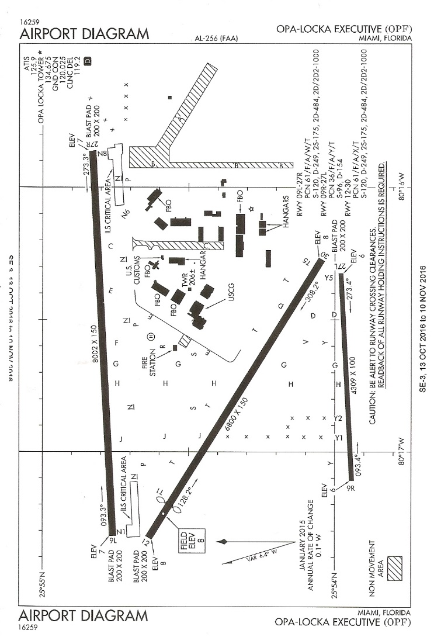
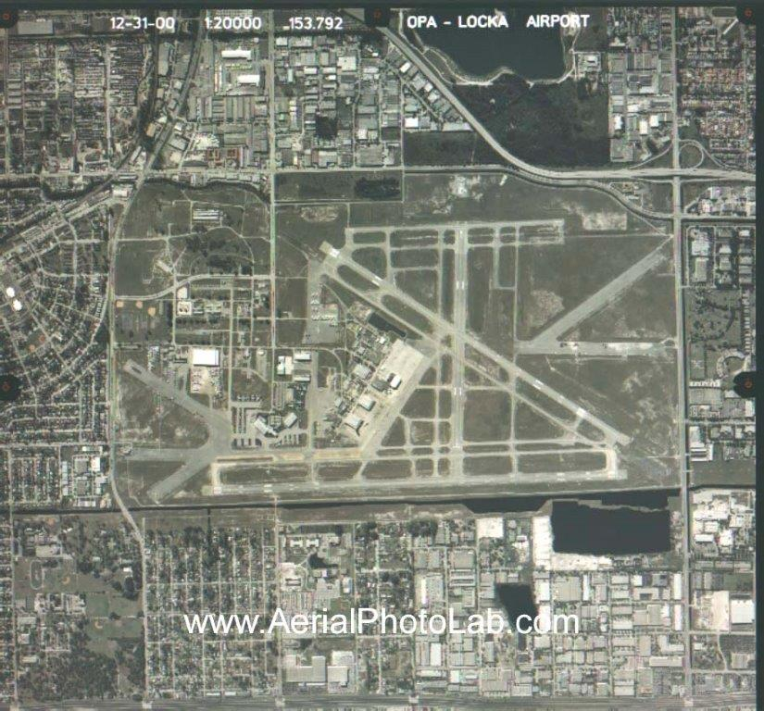
OPA LOCKA AIRPORT (OPF) Parking Plan to include Taxiway, USCG Air Station Miami, Fontainebleau Aviation (FBO) Exact Location of Aircraft TBD

Slide 10
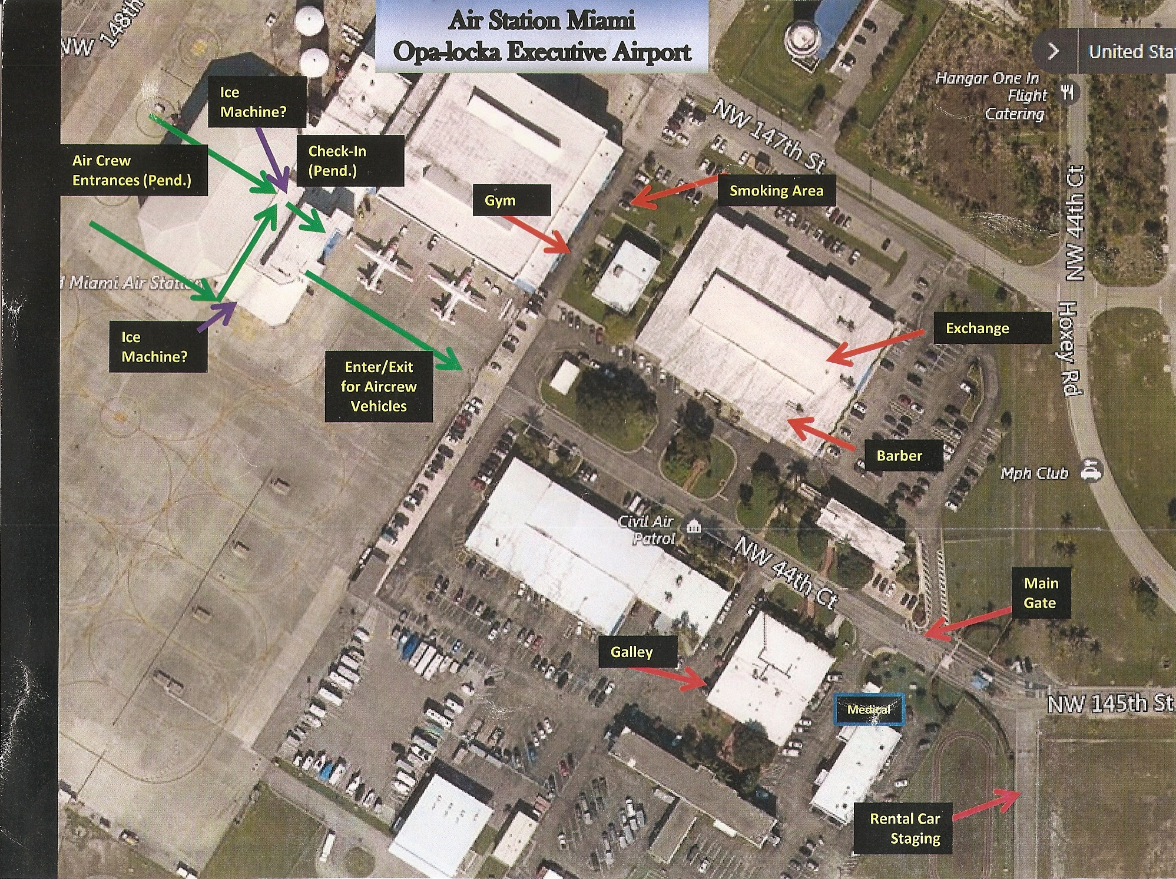

Slide 11
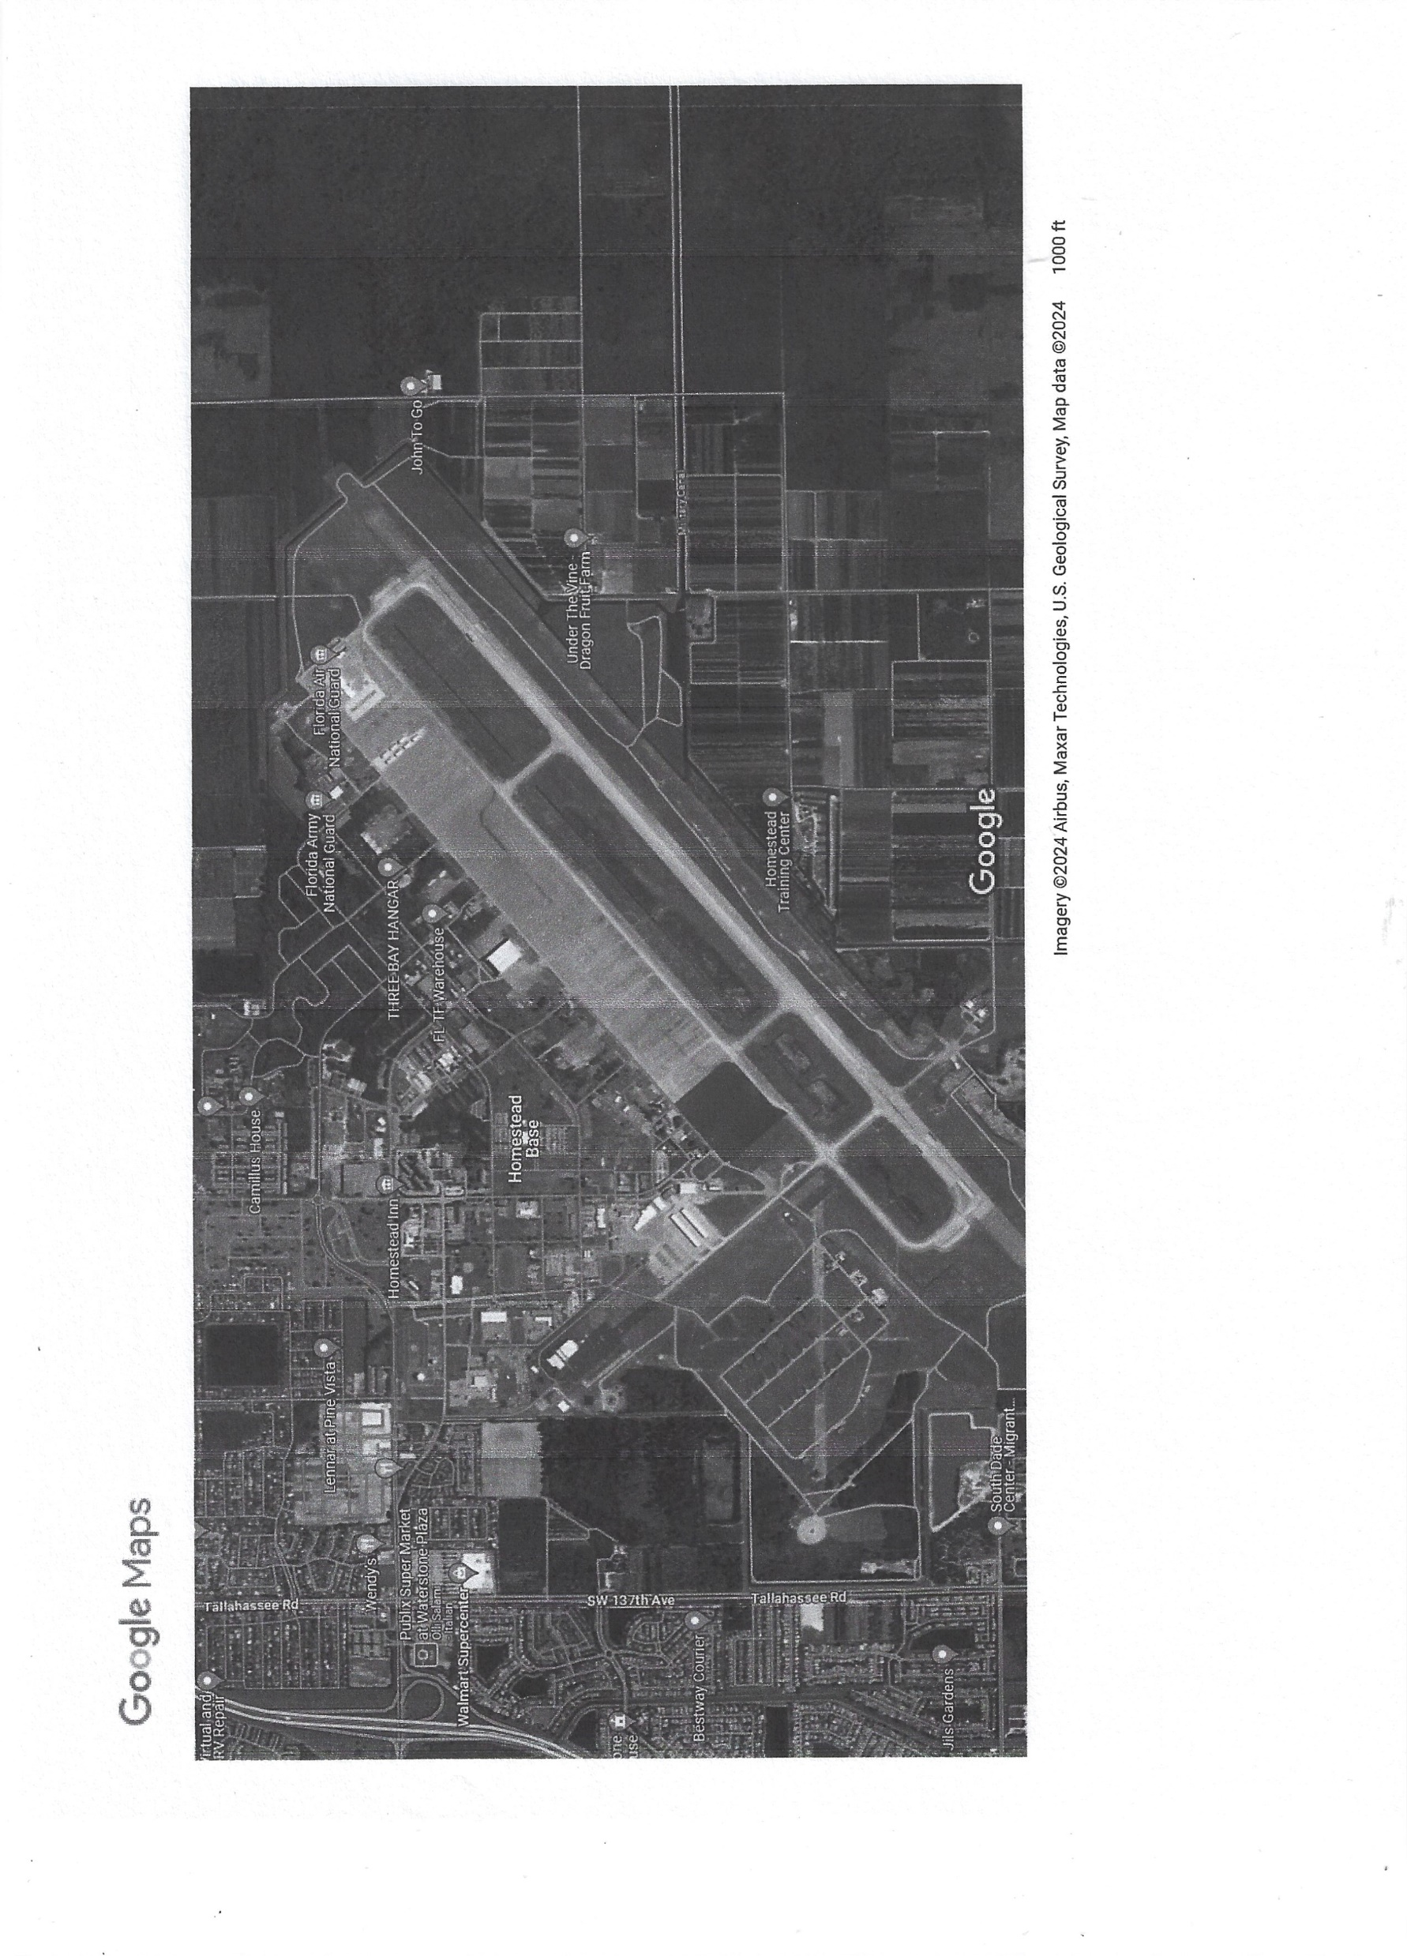
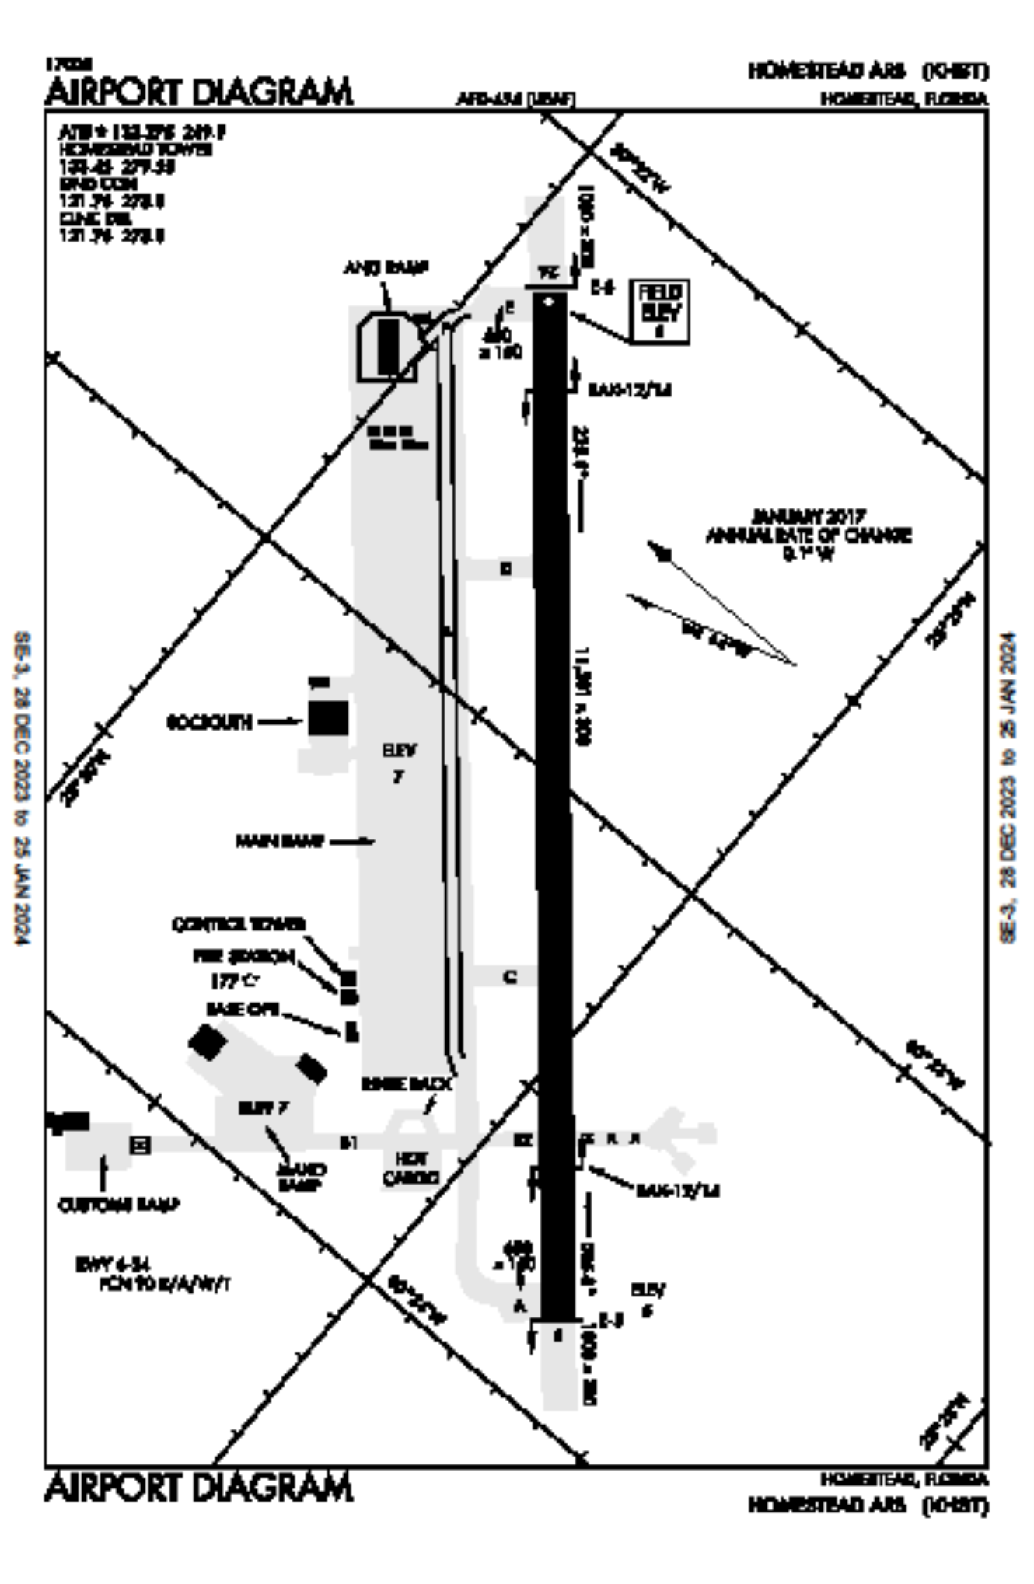
HOMESTEAD USAF RESERVE BASE (KHST)

Slide 12
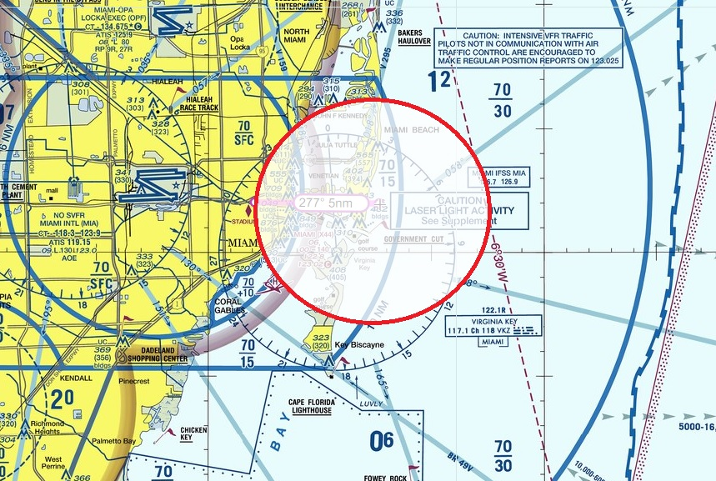
TFR

Slide 13
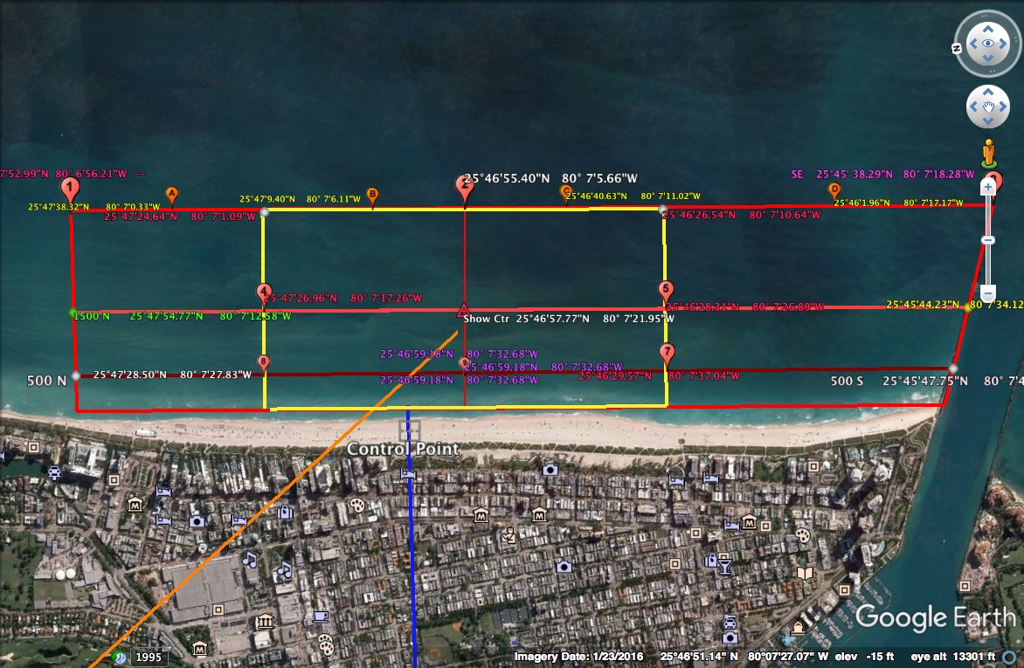
Aerobatic Box

Slide 14
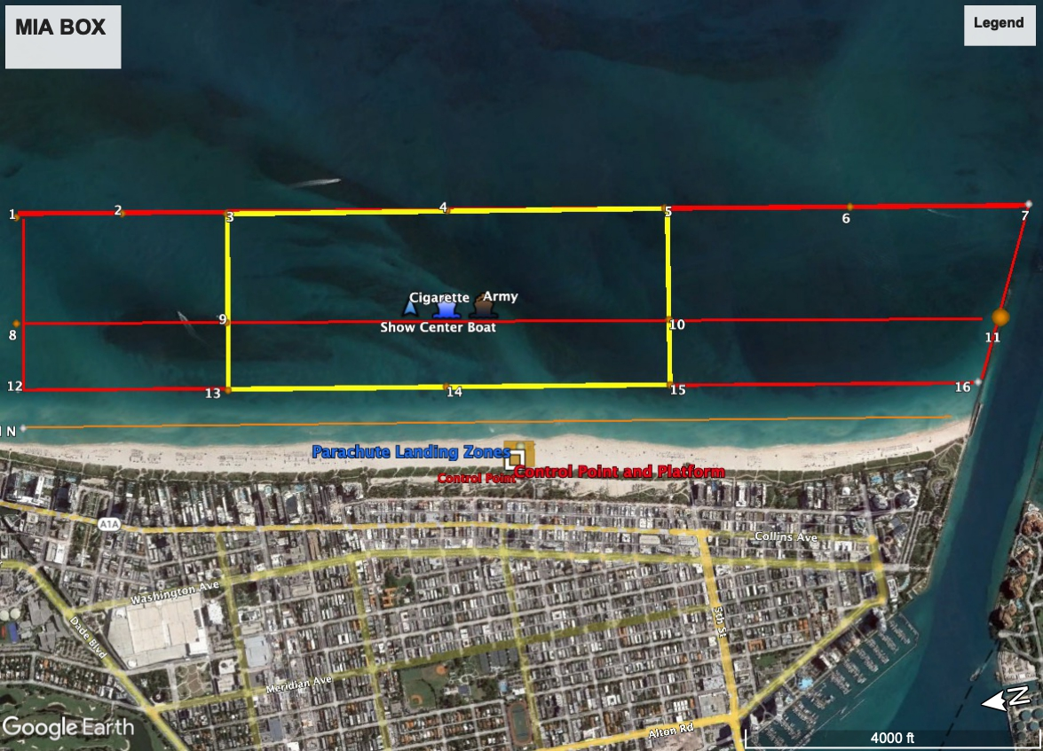
Aerobatic Box SHOW CENTER COORDINATES: 25* 40’ 57.75” N. 80* 07’ 21.97” W

Slide 15

SHOW CENTER BOAT TBD
TBD

Slide 16
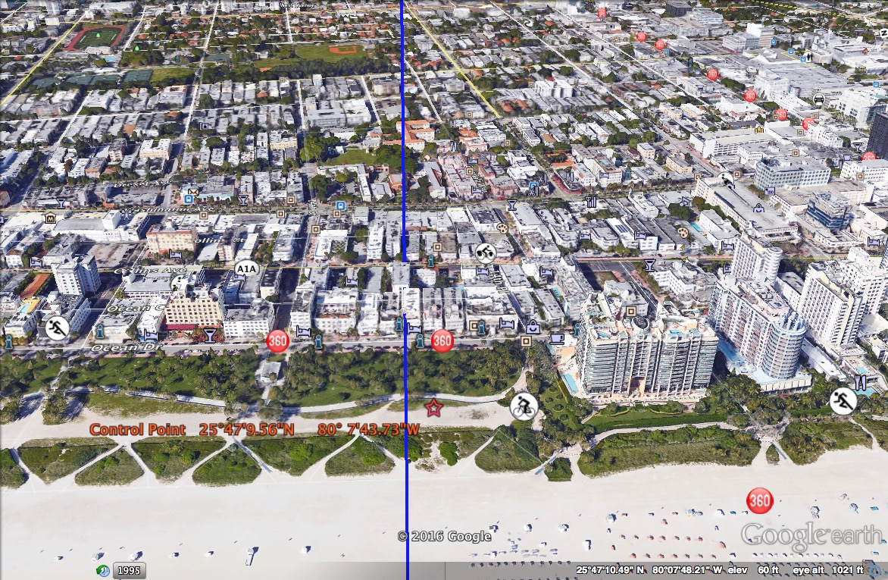
SHOW CENTER

Slide 17
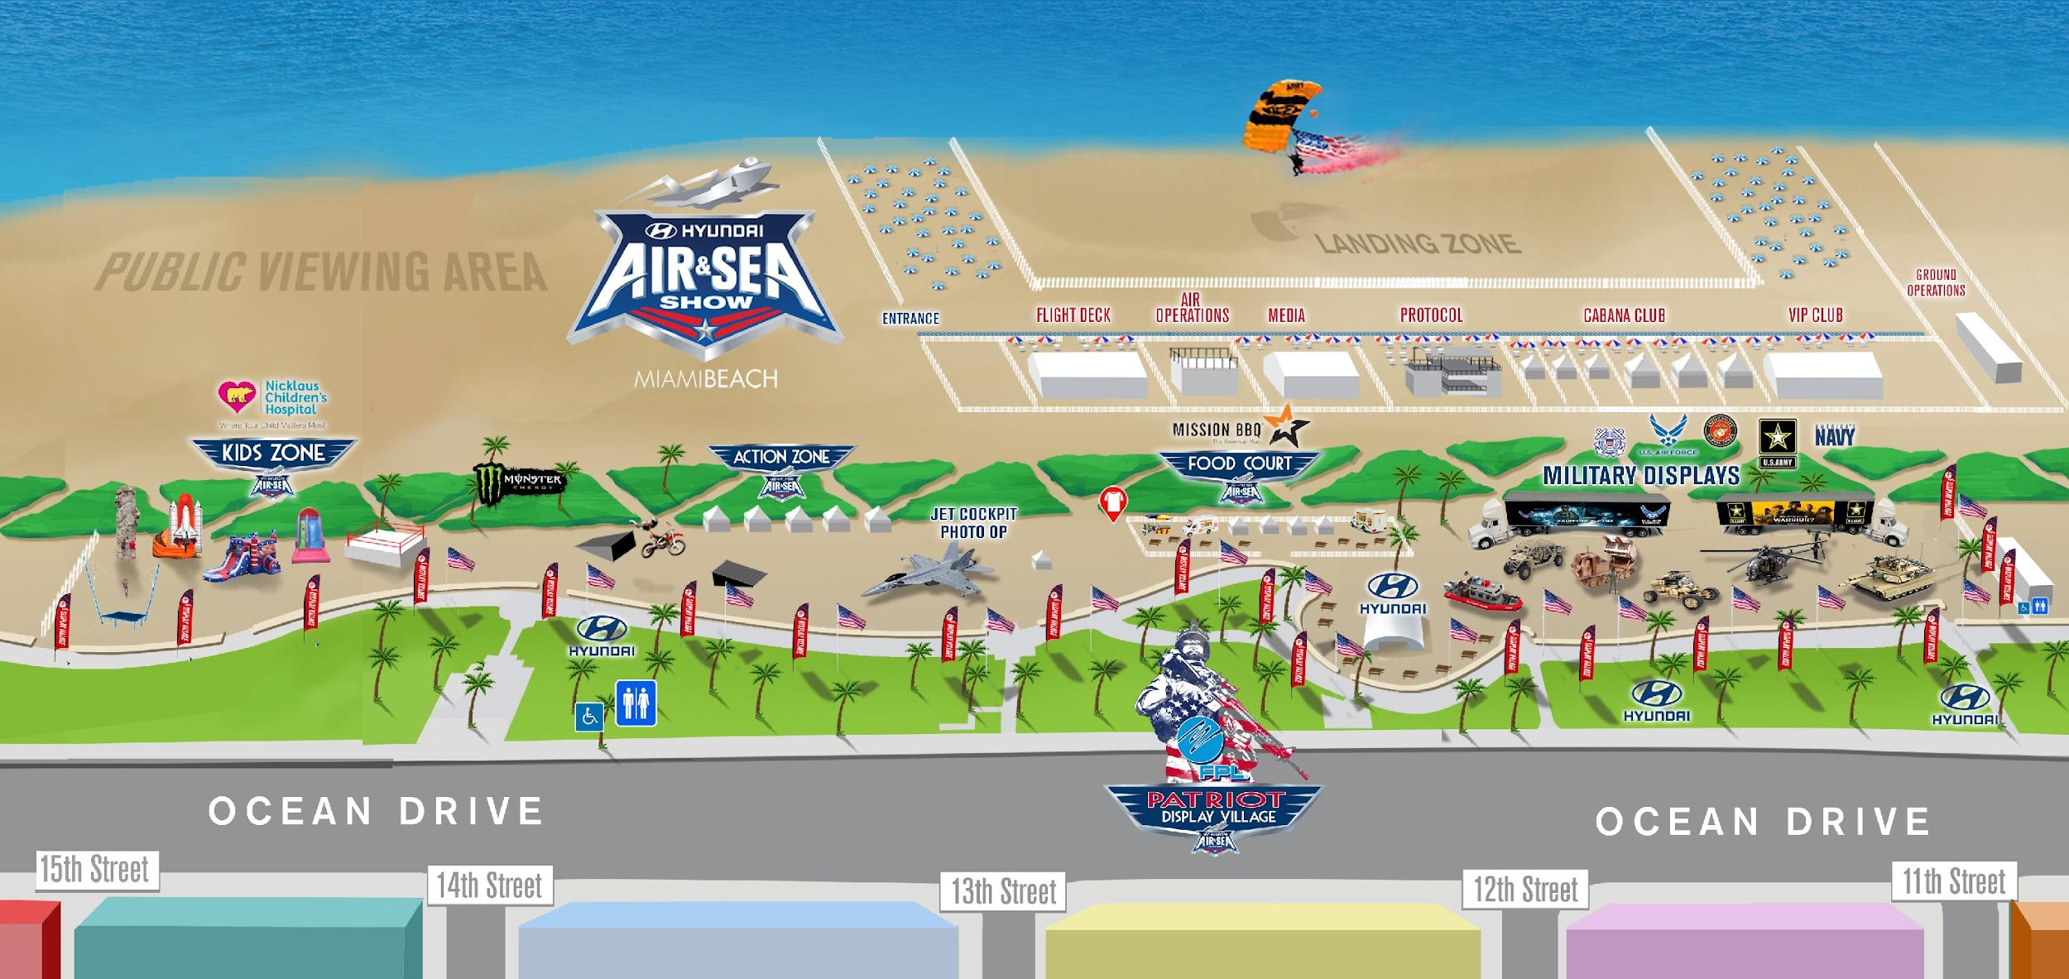
Air & Sea Show: Event Site Rendering

Slide 18
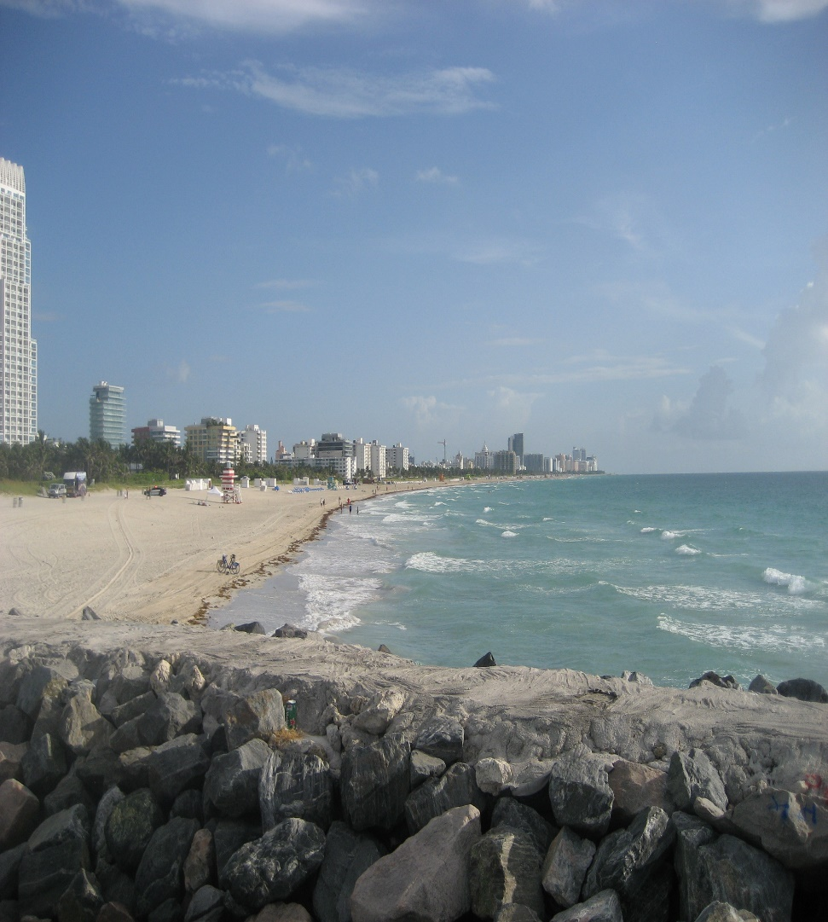
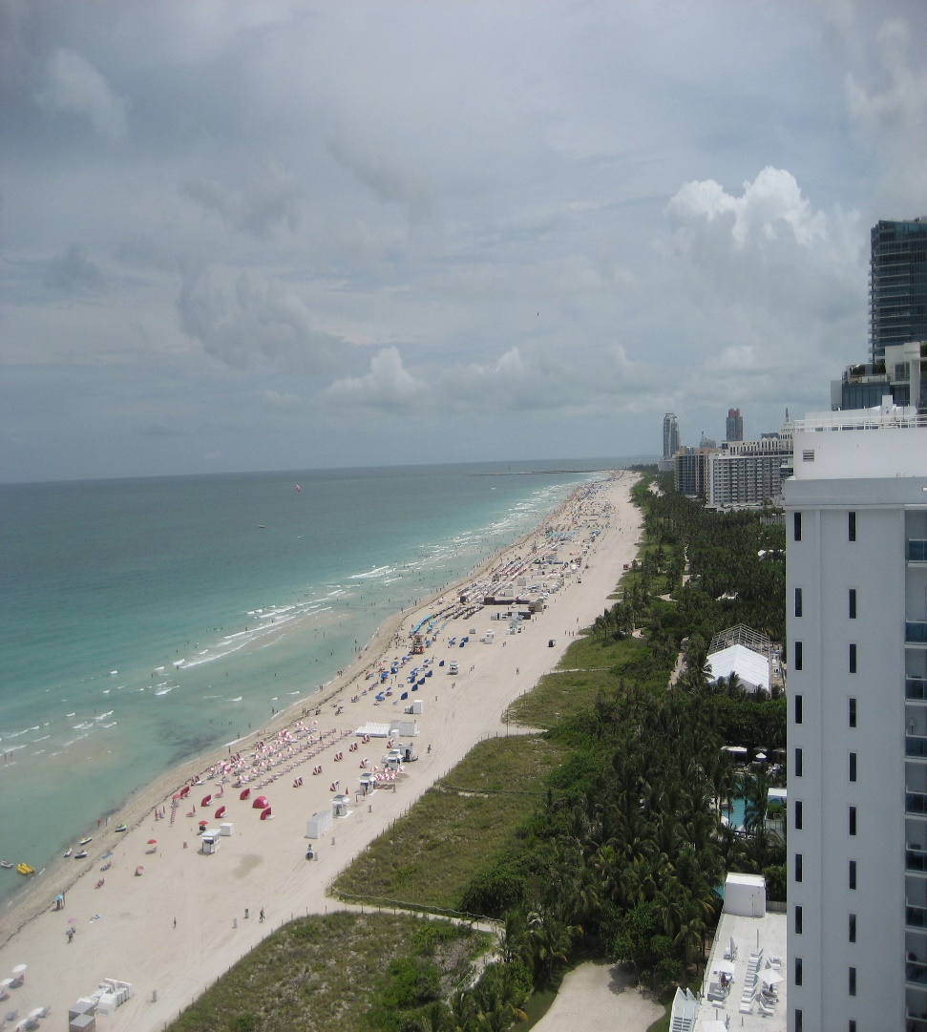
VIEWS N S

Slide 19
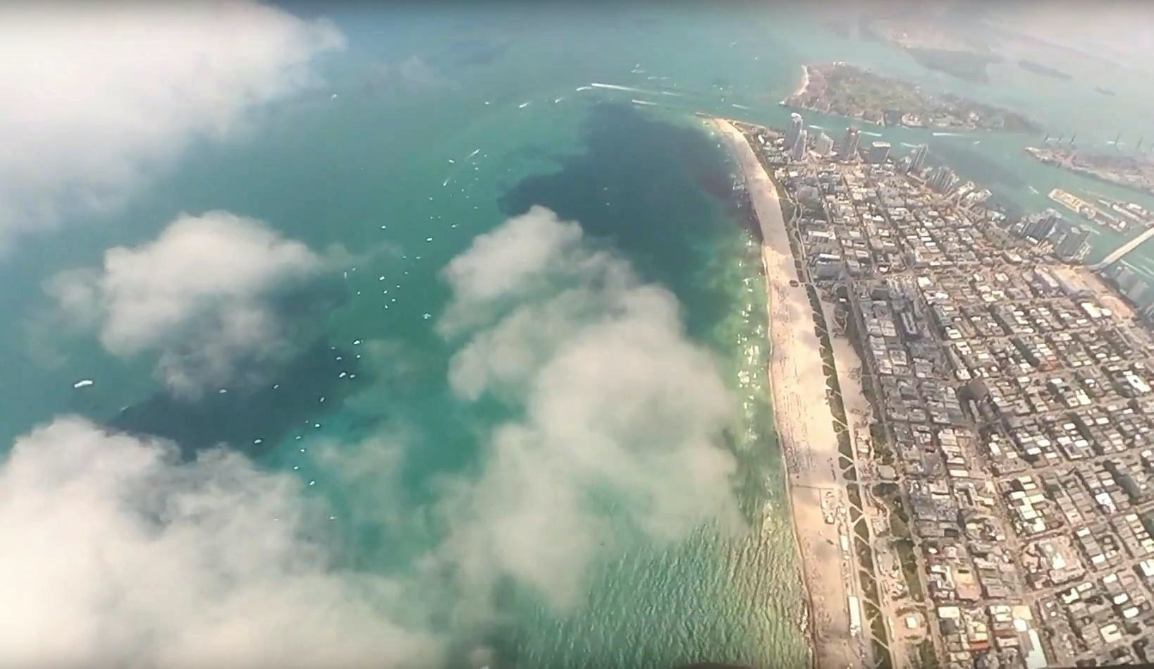
SHOW LINE

Slide 20
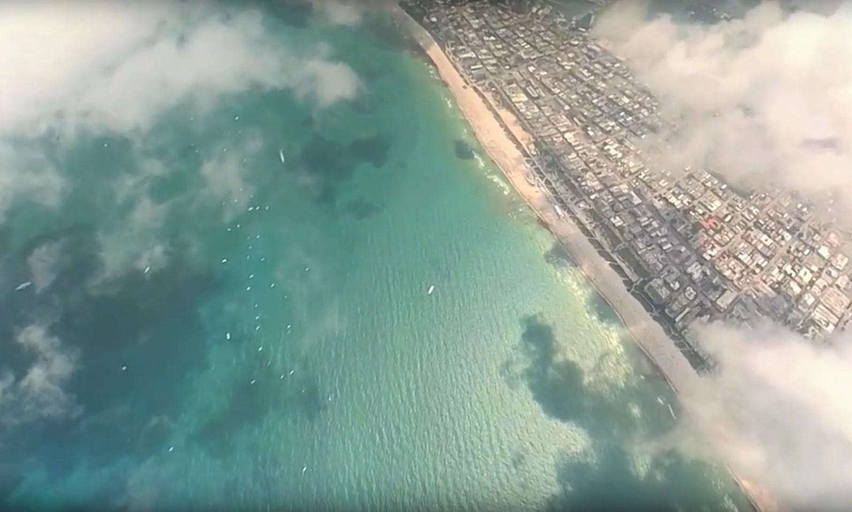
SHOW CENTER

Slide 21
Transition from Opa Locka to the Show Site (East or West)
Opa Locka tower will issue a discreet beacon code to each departure or flight.
Opa Locka tower will instruct show aircraft to proceed to the Transition Holding Point (THP) @ 25* 52’ 38.00” N, 79* 58’ 23” W or if requested, contact MIA departure (Z) on frequency xxx.xx (TBD) for vectors. Aircraft shall maintain VFR at 2500 MSL until in contact with the Air Boss.
If necessary, Miami departure will direct/vector performing aircraft to the THP. The Air Boss will be delegated altitudes from 3000’ to 5000’ MSL in the THP (see diagram).
Aircraft will hold at THP until called into the TFR by the Air Boss. All aircraft will maintain their assigned altitude until entering the TFR.

Slide 22
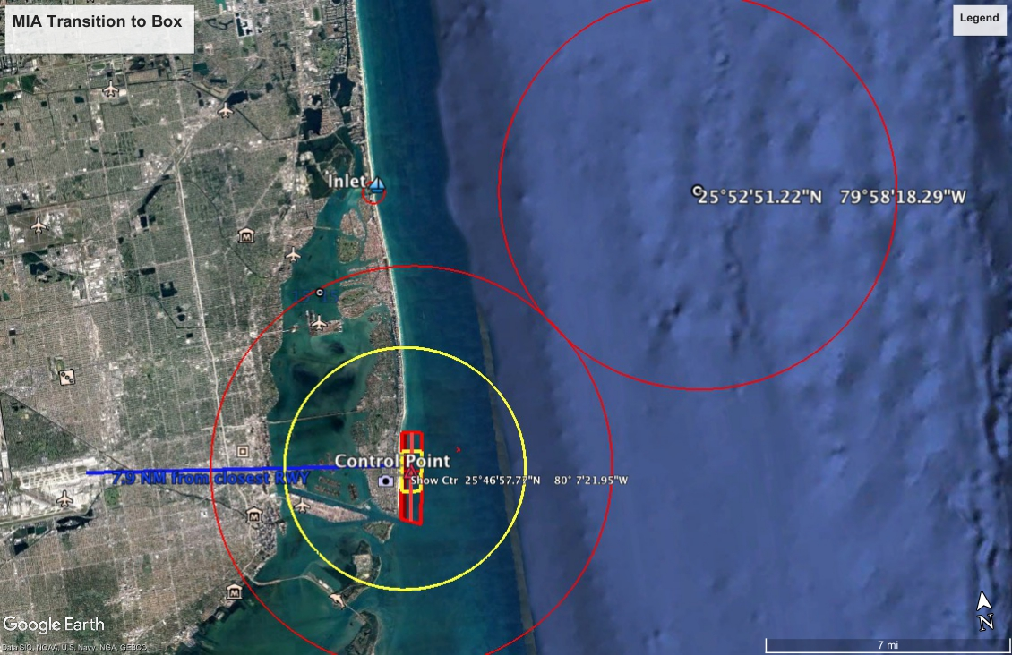

Slide 25
Aircraft Departing Show Center for KHST
For Aircraft Operating out of KHST
After completing demonstrations, Fly Heading 140 degrees and contact MIA Departure on 125.5 for vectors back to KHST

Slide 26
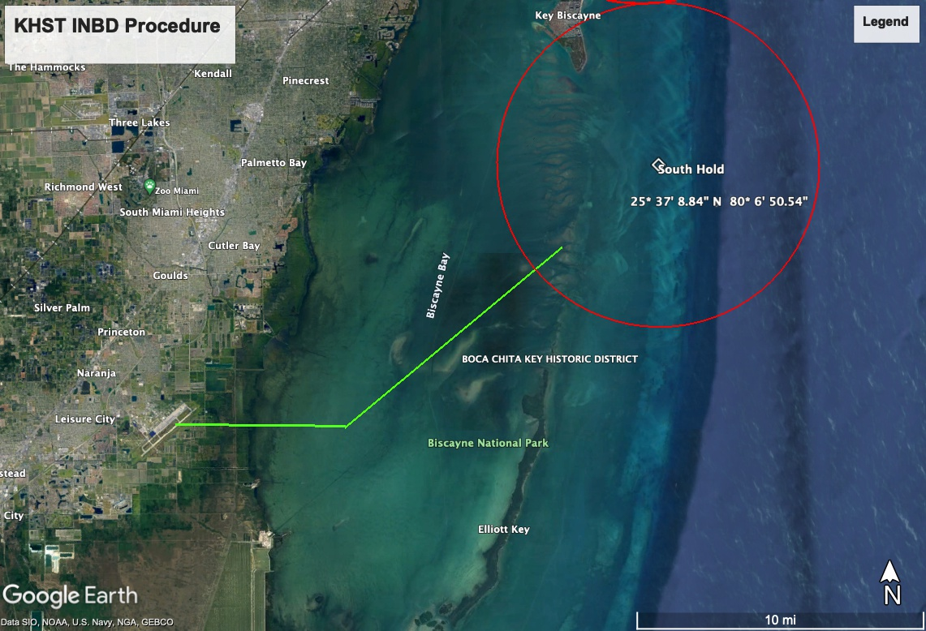
KHST TRANSITION TO BOX

Slide 27
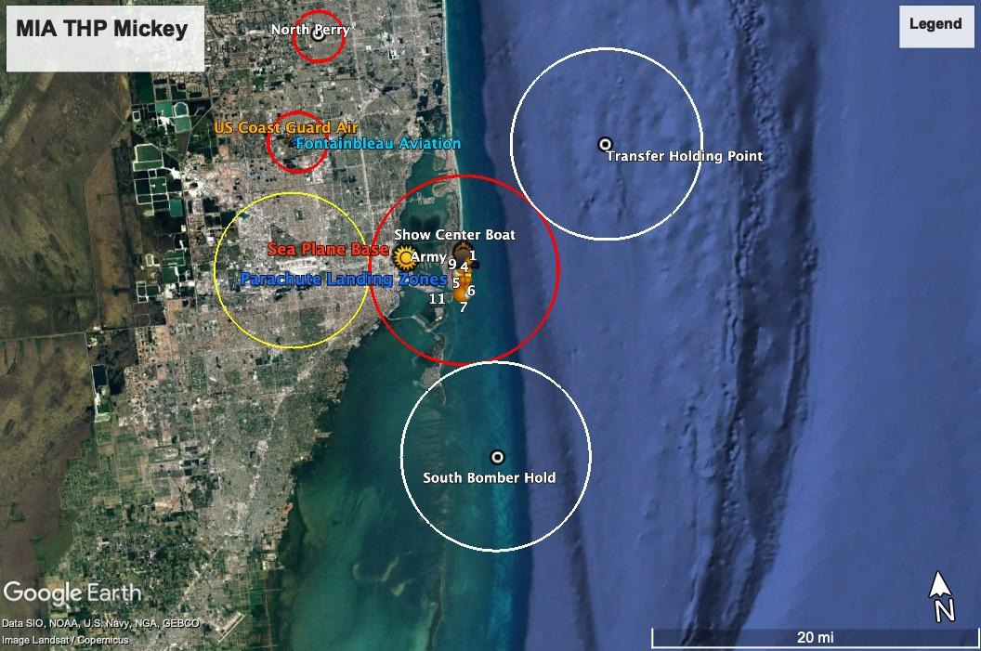
TFR and HOLDING

Slide 28
ARRESTING BARRIER
IN THE EVENT OF A MILITARY AIRCRAFT EMERGENCY REQUIRING AN ARRESTING BARRIER….
Military Aircraft will be directed to Homestead Air Force Base (KHST)
Runway 6/24 (11201 x 300) has a BAK 12/14 at each end of the runway
E60-24 | BAK-14 BAK-12B(B) (1087 FT) HOOK E5 (74 FT OVRN).
E60-06 | HOOK E5 (65 FT OVRN) BAK-14 BAK-12B(B) (1650 FT).
- | A-GEAR: APCH END BAK-12B(B)/14 FOR ACTIVE RWY IN LO POSN. DEP END BAK-12B(B)/14 FOR ACTIVE RWY IN RAISED POSN. E-5 CONNECTED ON DEP END, DISCONNECTED ON APCH END.

Slide 29
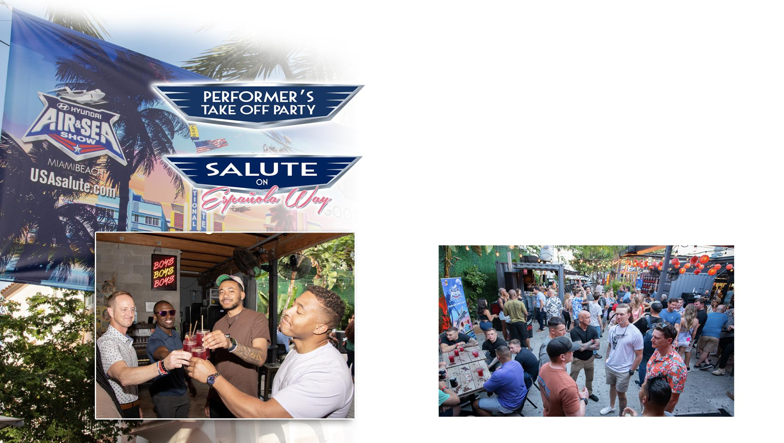
Performer’s Parties
Thursday, May 22: Performers Take Off Party
Location: TBD
Time: 6:30pm-9:00pm
Friday, May 23: Salute on Española Way
Location: Española Way
Time: 6:30pm-9:00pm
Saturday, May 24: TBD
Sunday, May 25: TBD

Slide 30
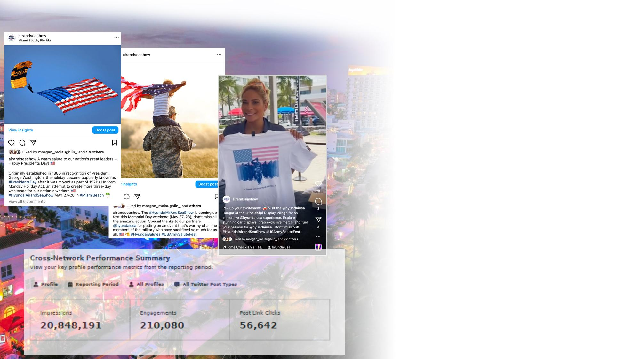
Social Media
Hyundai Air and Sea Show
Instagram: @airandseashow
Facebook: @airandseashow
Twitter: @airandseashow
TikTok: @airandseashow
Tags to search for GIFS:
HASS25
HASHTAGS
#HyundaiAirAndSeaShow
#USASalute
#HyundaiSalute
2024 In Review
24+ Million Impressions
173,000+ Overall Engagements
2+ Million Video Views
10 Instagram LIVE including Mayor of Miami Beach and representatives from all branches of the military.
LIVE on-site coverage throughout the weekend of events.

Slide 31

Public Relations
NATIONAL, REGIONAL AND LOCAL MEDIA
In 2024 we were in 278 stories
Coverage in national news outlets:
AOL, AARP, MSN, Yahoo
Coverage across regional print media & online media outlets:
City & Shore, Brickell Magazine, Lifestyle Magazine, Miami Herald
Broadcast Media
English
WFOR-CH4 (CBS)
WTVJ- CH6 (NBC)
WSVN- CH 7 (FOX)
WPLG - CH 10 (ABC)
Spanish
Telemundo – CH 51, Univision-CH23
Coverage in National, Local and Regional Calendar Event Listings
2024 TOTAL AUDIENCE OF 939 MILLION

Slide 32
MISSION STATEMENT
Safe, secure, entertaining, professional and efficient execution of full range of activities encompassing the Miami Beach Air & Sea Show as part of the National Salute to America’s Heroes.
THANK YOU
Ted Plana
Air Operations Director
burritoted@aol.com

Slide 33
